Slide 1
Features that are relevant in Machine Learning
02/09/2024

Slide 2
Hyperparameter tuning:
Is the process of selecting the optimal set of hyperparameters for a machine learning model.
Hyperparameters are configuration settings for a model that are not learned from the data but must be set before the training process begins.
The goal of hyperparameter tuning is to find the hyperparameter values that result in the best performance of the model on a specific task.
Technique: Cross-Validation
Data Preprocessing:
is preparing (cleaning and organizing) the raw data to make it suitable for a building and training Machine Learning models
Technique: Normalization

Slide 3
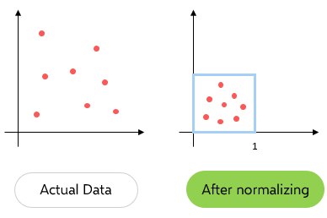
Normalization:
is a preprocessing step that scales and centers numerical features in a dataset.
Goal: bring all features to a similar scale, preventing certain features from dominating others due to differences in their magnitudes.
Why is normalization necessary?
Many machine learning algorithms are sensitive to the scale of input features. Without normalization, features with larger scales can have a disproportionate impact on the model, leading to biased results.
Main approach:
Min-Max Scaling (MinMaxScaler): Rescales the features to a specific range, often between 0 and 1.

Slide 4
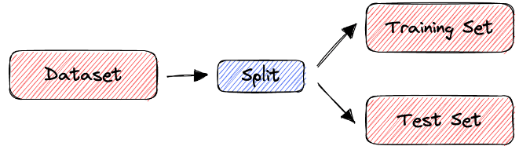
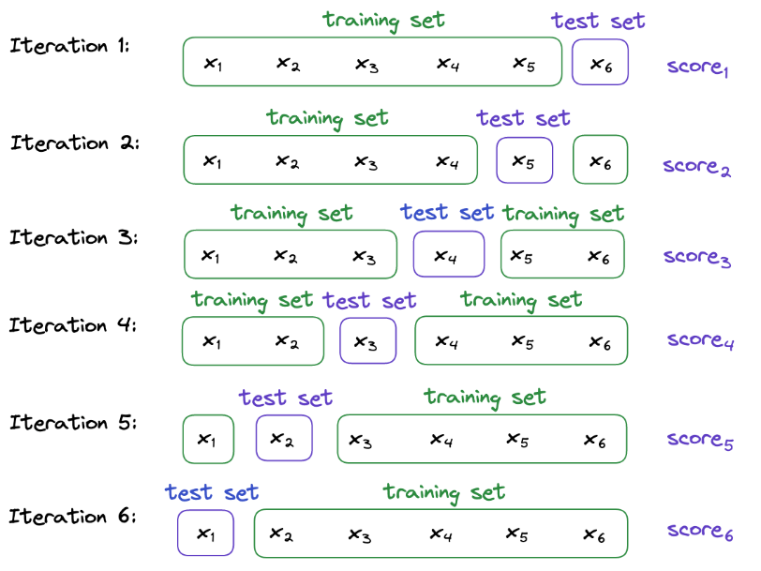
Cross-Validation:
is a resampling technique used to assess the performance and generalization of a machine learning model. It involves splitting the dataset into multiple subsets, training the model on some subsets, and evaluating it on the remaining subsets.
Goal: detect issues like overfitting or underfitting and provides a more reliable assessment of how well the model will generalize to new, unseen data.
Main approach:
Leave-One-Out Cross-Validation (LOOCV)
K-Fold Cross-Validation

Slide 5
Main types of Approach
Supervised
Unsupervised
Reinforcement.

Slide 6
Supervised
The computer is presented with example inputs and their desired outputs, given by a "teacher", and the goal is to learn a general rule that maps inputs to outputs.
An optimal function allows the algorithm to correctly determine the output for inputs that were not a part of the training data. An algorithm that improves the accuracy of its outputs or predictions over time is said to have learned to perform that task

Slide 7
Unsupervised
Unsupervised learning algorithms find structures in data that has not been labeled, classified or categorized. Instead of responding to feedback, unsupervised learning algorithms identify commonalities in the data and react based on the presence or absence of such commonalities in each new piece of data

Slide 8
Reinforcement
A computer program interacts with a dynamic environment in which it must perform a certain goal (such as driving a vehicle or playing a game against an opponent). As it navigates its problem space, the program is provided feedback that's analogous to rewards, which it tries to maximize.

